Slide 1
Logic Circuits – Exercise 2.1
By Andrei Cotor, Group 911

Slide 2
Problem Statement
For each of the following Boolean functions draw the corresponding logic circuit using derived gates, simplify the function and draw the logic circuits associated to all simplified forms of the initial function using only basic gates
f₁(x, y, z) = x (y ⊕ z) ∨ y (x ⊕ z) ∨ x ( ¯y ↓ ¯z) ∨ (x ↓ y)¯z

Slide 3
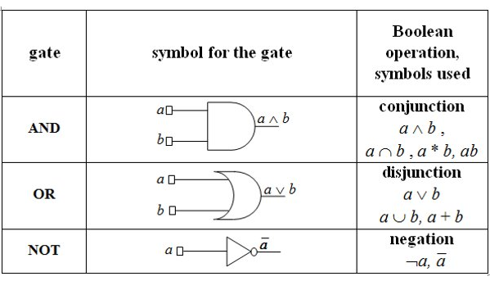
Theory – Basic gates

Slide 4
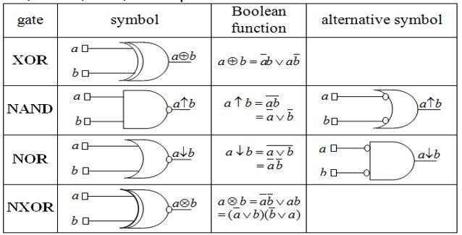
Theory – derived gates

Slide 5
Theory – simplification process
Obtain DCF (disjunctive canonical form) by creating the Truth Table of the function f₁ and the minterms
Use Karnaugh’s simplification method
Obtain the set of maximal monoms by factorization
Obtain the set of central monoms (a maximal monom is a central monom if its corresponding group of minterms contains at least a minterm only circled once)

Slide 6
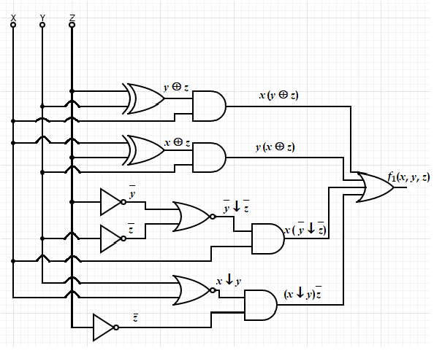
Logic Circuit – Derived Gates

Slide 7
f₁(x, y, z) = x (y ⊕ z) ∨ y (x ⊕ z) ∨ x ( ¯y ↓ ¯z) ∨ (x ↓ y)¯z
x | y | z | y ⊕ z | x ⊕ z | ¯y ↓ ¯z | x ↓ y | x (y ⊕ z) | y (x ⊕ z) | x ( ¯y ↓ ¯z) | (x ↓ y)¯z | f₁(x, y, z)
0 | 0 | 0 | 0 | 0 | 0 | 1 | 0 | 0 | 0 | 0 | 1
0 | 0 | 1 | 1 | 1 | 0 | 0 | 0 | 0 | 0 | 0 | 0
0 | 1 | 0 | 1 | 0 | 0 | 1 | 0 | 0 | 0 | 1 | 1
0 | 1 | 1 | 0 | 1 | 1 | 0 | 0 | 1 | 0 | 0 | 1
1 | 0 | 0 | 0 | 1 | 0 | 0 | 0 | 0 | 0 | 0 | 0
1 | 0 | 1 | 1 | 0 | 0 | 0 | 1 | 0 | 0 | 0 | 0
1 | 1 | 0 | 1 | 1 | 0 | 0 | 1 | 1 | 0 | 0 | 1
1 | 1 | 1 | 0 | 0 | 1 | 0 | 0 | 0 | 1 | 0 | 1
m₀
m₂
m₃
m₆
m₇
DCF(f)=m₀ $∨$ m₂ $∨$ m₃ $∨$ m₆ $∨$ m₇ = $\left(\overline{x}∧\overline{y}∧\overline{z}\right)∨(\overline{x}∧y∧\overline{z})∨(\overline{x}∧y∧z)∨(x∧y∧\overline{z})∨(x∧y∧z)$

Slide 8

Simplification – Karnaugh’s method
x yz | 00 | 01 | 11 | 10
0 | m₀ |  | m₃ | m₂
1 |  |  | m₇ | m₆
Factorization process:
max₁ = m₂ $∨$ m₃ $∨$ m₆ $∨$ m₇ = y
max₂ = m₀ $∨$ m₂ = $\overline{x}$ $\overline{z}$
The set of maximal monoms: M(f) = {max₁, max₂} = {y, $\overline{x}$ $\overline{z}$}
The set of central monoms: C(f) = {max₁, max₂} = {y, $\overline{x}$ $\overline{z}$}, because for max₁ we have m₃, m₆, m₇ circled once, for max₂ we have m₀ circled once.

Slide 9

Simplification – Karnaugh’s method
M(f) = C(f) => the first case of the simplification algorithm applies
There is a unique simplified form and it is:
$f_{1}^{S}=$ max₁ $∨$ max₂ = y $∨$ $\overline{x}$ $\overline{z}$

Slide 10
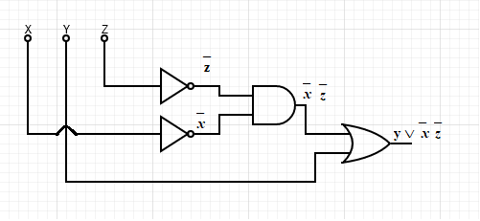
Logic Circuit – Simplified form
$f_{1}^{S}=$ max₁ $∨$ max₂ = y $∨$ $\overline{x}$ $\overline{z}$

Slide 11
THANK YOU!

